Slide 1
Emission Performance Standard Rulemaking
Overview Presentation
Aaron Tam, Electric & Natural Gas Data Specialist
Austin Scharff, Senior Energy Policy Specialist
Glenn Blackmon, Director, Energy Policy Office
2/8/2024

Slide 2
Agenda
Introductions
Purpose of meeting
Review RCW 80.80
EPS 194-26 WAC
Stakeholder and technical subgroup
EPS calculator
Timeline
Adjourn

Slide 3
Review of RCW 80.80
Definitions, survey of commercially available and purchased CCCTs, GHG EPS-Review

Slide 4
RCW 80.80.010, some definitions
“Combined-cycle natural gas thermal electric generation facility" means a power plant that employs a combination of one or more gas turbines and steam turbines in which electricity is produced in the steam turbine from otherwise lost waste heat exiting from one or more of the gas turbines.
"Baseload electric generation" means electric generation from a power plant that is designed and intended to provide electricity at an annualized plant capacity factor of at least sixty percent.
Notes:
An important note is that there may be a need for new fossil generation resources to provide intermediate load generation to balance intermittent and seasonal wind and solar generation and to provide peak power generation to cover periods of high electrical demand. This new generating capacity is often provided by new simple cycle combustion turbines, frame type combustion turbines, or “fast-start” combined cycle combustion turbine plants. Simple cycle combustion turbines typically operate at a lower efficiency and thus emit more emissions of GHG per MWh. These plants are designed and intended to operate at less than baseload rates, and this law does not apply to these types of plants.

Slide 5
RCW 80.80.050, 5-year CCCT Survey
The energy policy division of the department of commerce shall provide an opportunity for interested parties to comment on the development of a survey of new combined-cycle natural gas thermal electric generation turbines commercially available and offered for sale by manufacturers and purchased in the United States to determine the average rate of emissions of greenhouse gases for these turbines. The department of commerce shall report the results of its survey to the legislature every five years, beginning June 30, 2013. The department of commerce shall adopt by rule the average available greenhouse gases emissions output every five years beginning five years after July 22, 2007.
Notes:
A key word in the third paragraph above is “survey”. Commerce initially interpreted the word to mean the entire analytical process undertaken to establish the establish the EPS, but during the 2012-13 rulemaking (2012 rulemaking from here on) process realized that it was helpful in communicating with stakeholders to present the analytical process as being comprised of two separate parts.
The first part is the actual survey, or accounting, of the CCCTs that utilities are purchasing and installing within the previous five calendar years. The second part is the series of calculations required to determine the average available GHG emissions output value, and is referred to as the EPS calculator. Commerce will determine the average rate of greenhouse gases for these turbines, and that will serve as the basis for the new baseload electric generation EPS. This ensures that utilities are using average or above-average efficiency combustion turbines.

Slide 6
RCW 80.80.080, EPS 5-year Review
For the purposes of RCW 80.80.040 through 80.80.080 and 80.70.020, the department [of ecology], in consultation with the department of commerce energy policy division, the energy facility site evaluation council, the commission, and the governing boards of consumer-owned utilities, shall review the greenhouse gases emissions performance standard established in this chapter to determine need, applicability, and effectiveness no less than every five years following July 22, 2007, or upon implementation of a federal or state law or rule regulating carbon dioxide emissions of electric utilities, and report to the legislature.
Notes:
Department of Ecology is in the process of finalizing this 5-year review report as of this moment.

Slide 7
EPS 194-26 WAC
Review the current average available emissions output and current NW plants

Slide 8
Ch. 194-26 WAC: GHG Emission Performance Std.
Average available greenhouse gas emissions output
The energy policy division of the department of commerce has surveyed new combined-cycle natural gas thermal electric generation turbines commercially available and offered for sale by manufacturers and purchased in the United States, and finds the average rate of emissions of greenhouse gases for these turbines to be nine hundred and twenty-five pounds per megawatt-hour…
Notes:
This is the current rule that we have in place for the average rate of emissions of combined-cycle combustion turbines in the U.S. This was established in 2018.

Slide 9
WAC 196-24, Current EPS and reported emissions
Current EPS: 925 lb/MWh
Average Reported Emissions (2018):
14 Northwest CCCTs: 949 lb/MWh
Excluding two highest: 875 lb/MWh
Newer (7) CCCTs: 845 lb/MWh
Notes:
This slide compares the current EPS to the most recent analysis of avg reported emissions amongst NW CCCTs. The 1st bullet shows the average emissions rate from all 14 NW CCCTs. The 2nd bullet highlights another subset comparison which excludes the two highest emitting CCTs in the PNW (Centralia’s Big Hanaford coal-fired power plant and Ferndale Generating Station). The last comparison shows the average emissions output of the newer CCCTs.

Slide 10
Current EPS and reported emissions
Notes:
This graph compares the calculated GHG emissions to those reported to federal agencies. Reported emissions are consistently estimated to be lower than the calculated emissions using the EPS calculator methodology as can be seen in this graph. This graph also shows the difference between the 2013 and 2018 EPS, and its impact on NW CCCTs. This graph shows that most of the NW CCCTs remain below the national average emissions output for 2013 and 2018 with two outliers.

Slide 11
Stakeholder and Technical Subgroup
Discuss purpose and duties

Slide 12
Notes:
The stakeholder group meetings in the future will be informational meetings open to all similar to this one where stakeholders who are interested in the EPS subject can joint the list service and be informed about updates and process of the EPS.

Slide 13
EPS Technical Subgroup
For practical reasons Commerce prefers to limit this group in size
1-2 representatives from:
utilities or entities who own or operate CCCTs
major environmental or energy efficiency organizations
major state agencies
Objective will be to hold three meetings with some homework in between
Email distribution of draft materials for review and comments
Notes:
The technical group will be more deeply involved in the average available greenhouse gas output, and will be composed of…^ (see slide)

Slide 14
EPS Technical Subgroup Topics
Convene a technical subgroup to discuss the following:
The CCCTs to be included or excluded from the survey.
Establish heat rate adjustment factors including, CCCT capacity factor; gross to net; duct firing percent, duct firing hours and rate; and CCCT aging (performance degradation).
Develop adjustment factors for low output operation, and stop/start cycling.
Develop adjustment factors for CCCT cooling technology, operating conditions (climate) and inlet cooling.
Develop an EPS calculator with above factors.
Notes:
1st part is the CCCT survey: for instance: for the 2017 survey, we focused primarily on CCCTs of “1x1” architecture (one combustion turbine followed by one steam turbine) as this is the primary format used in the Northwest.
2nd part is the assumptions that go into the EPS calculator: gross to net refers to on-site parasitic losses to run equipment mean the net power available to the power grid is slightly lower than the gross value, capacity factor is annual output as a % of adjusted max rate capacity. Duct firing adjustment: CCCTs often have supplemental and lower efficiency duct firing that can boost facility output for a short period of time.

Slide 15
EPS Survey & Calculator
Review process and methodology

Slide 16
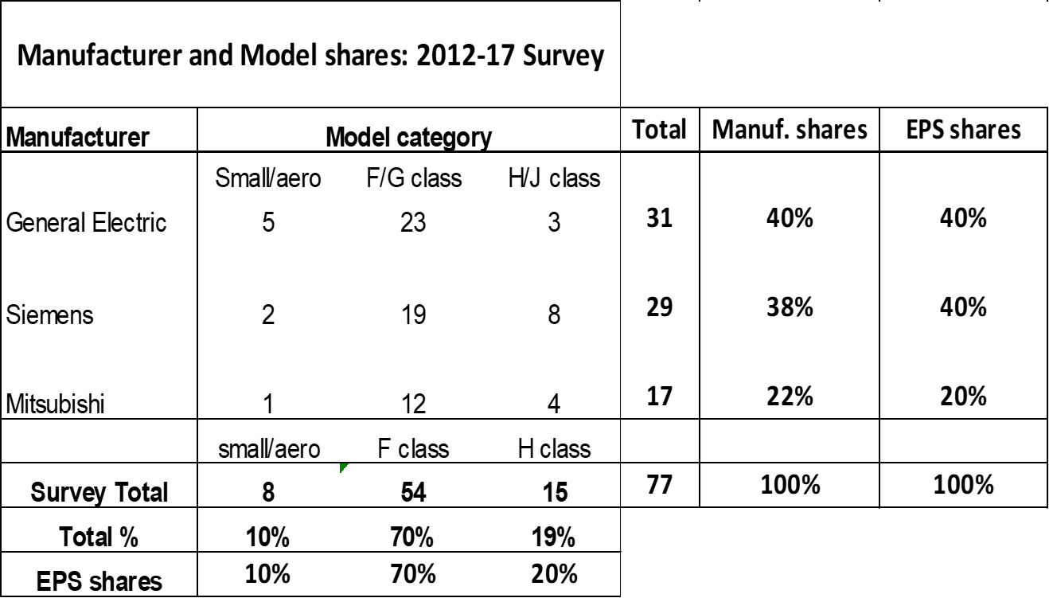
Survey of 2012-17 U.S. CCCT Installations
Notes:
This is an example survey of the 2012-2017 U.S. CCCT installations. You can see the 3 major manufacturers are General Electric, Siemens, and Mitsubishi, and their plants sold in the U.S. are broken down by category. The last row and column compares the larger sample to a smaller representative subsample that was used for the EPS calculator.

Slide 17
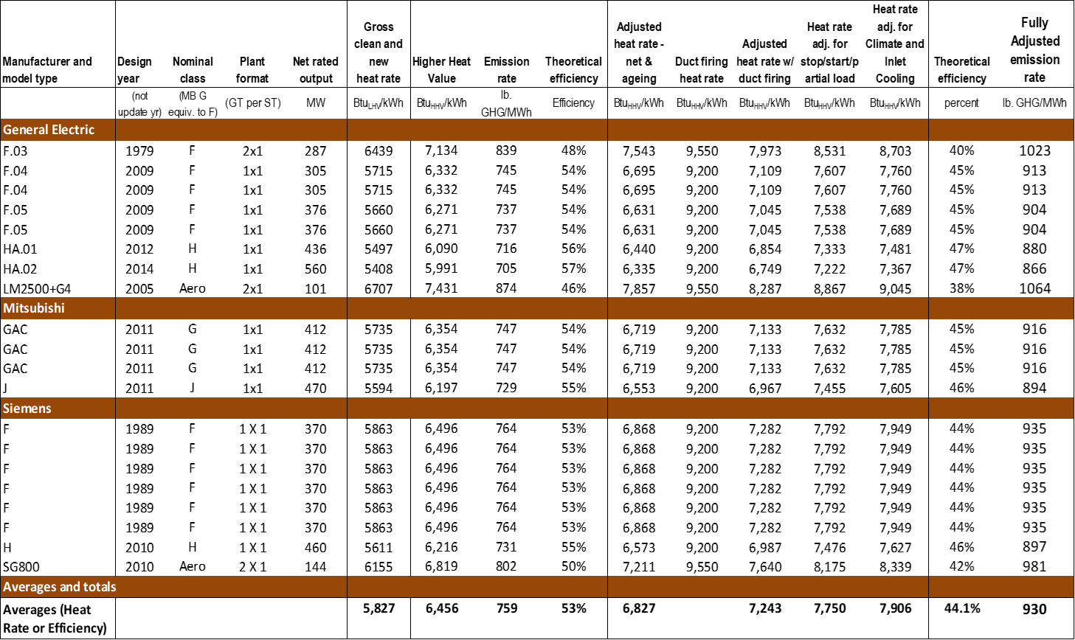
CCCTs 2018 EPS Calculator
Notes:
This shows what the EPS calculator looks like taking a representative sample of CCCT plants from the survey. As you can see a number of adjustments and calculations are made to arrive to the fully adjusted emissions rate.
The process starts with determining the final adjusted heat rate for all CCCT configurations. Then that heat rate is multiplied by the natural gas emission factor to arrive at an emission rate of pounds CO2 per MWh for all CCCTs.
We also add standard values (lb/MWh) for methane and nitrogen oxides emissions based on Department of Ecology reports.
Average emission factor: the average across all CCCT configurations to arrive at the average available GHG emissions output (used as the basis for the updated emission performance standard).

Slide 18
Timeline

Slide 19
EPS Timeline
February 2024: Notice of initial intent to undertake rulemaking (form CR-101)
March 2024: First stakeholder meeting
April-June 2024: Commerce designs EPS survey/calculator in collaboration with stakeholders.
May-June 2024: Second stakeholder mtg. and publication of a draft rule (form CR-102).
June-July 2024: Two public meetings to receive comments from interested parties on the rule.
August 2024: After considering the comments received during the above step Commerce will finalize and publish the final rule (form CR-103).
September-October 2024: The rule enters into force.
Commerce will report the final result of the rulemaking to the legislature.

Slide 20
Questions?

Slide 21
Thank you!
Aaron Tam
Electric & Natural Gas Data Specialist
aaron.tam@commerce.wa.gov
(206) 454-2251

