Slide 1
Small Business Innovation Fund
( SBIF)
Linda Womack
Managing Director,
Office of Economic DEVELOPMENT & Competitiveness
August 8, 2022/ WEDA hosted

Slide 2
Application Parameters
$34,500,000 of the coronavirus state fiscal recovery fund— federal appropriation is provided solely for a small business innovation and competitiveness fund program to spur small business recovery, startup, and growth, with a focus on initiatives that will serve BIPOC entrepreneurs and small businesses located in underserved, low-income, and rural areas.
The department will competitively award grants to nonprofit organizations that work with or provide assistance to small businesses. ( Municipalities, CBOs, EDOs, and not for profit entities statewide)
Local one-to-one match of state funding - encouraged but not required
equitable geographic distribution of funding statewide
Use of Funds:
Small business incubator programs;
Small business accelerator programs;
Local procurement initiatives;
Small business competitiveness programs focused on hiring and retention;
Improvements and repairs to physical workplaces, including in response to public health guidelines or acts of vandalism
Other initiatives determined by the department that supports the mission of the grant

Slide 3
Top Concerns of BIPOC/S/W business
1. Managing supply, logistics and demand
2. Keeping track of customers ( Business Operations efficiency)
3. Understanding cash flow & Keeping up with Taxes
4. Creating financial reports to inform business decisions
5. Sourcing and applying for business capital (least confident)
6. Retaining workforce & HR related matters ( has become more pervasive during and post covid)
7. Legal ( contract review and articles of incorporation)
79% said they are likely to use accounting support in the next 6-12 months
59% said they are likely to use marketing support the next 6-12 months
35% cite the lack of capital as their biggest obstacle

Slide 4
Addressing Equitable Distribution
Geographical distribution of funding?
The legislature has specified that: “The department may establish regional targets or other benchmarks to ensure equitable geographic distribution of funding.” In response to this, funds will be distributed according to the following regional framework:
1/3 all other urban counties
1/3 all other rural counties
1/3 King County
**Commerce has the discretion to negotiate dollar amounts of approved awards.
***Commerce reserves the right to not allocate all funding
Notes:
That’s the “rule of thumb” for HTF – 1/3 King, Urban, Rural. HTF’s statute say’s we’re to target 30% of funding for Rural communities, as defined by Commerce. Our definition is in the handbook. HTF Handbook Version 3-4-2021.pdf | Powered by Box
We differentiate “regional” and “geographic” distribution – geographic is Urban/Rural/King. Here’s the NOFA for the current round. 2022 Funding Round | Powered by Box
Deliverables Contract: Allows Commerce to pay for work in a non-reimbursable manner, i.e. progress reports, marketing strategies, media, etc.
Deliverables contracts deal more in incomes/outcomes, where the contractor gives us something that we then pay for. As opposed to reimbursement contracts, where we need line-item budgets and will reimburse once work is done, deliverables contracts allow us to pay when we receive we the materials we have specified for that invoice period in the contract. Allows us more flexibility and makes exactly what we need clear, and as long as we get those materials, we can pay with no problem

Slide 5
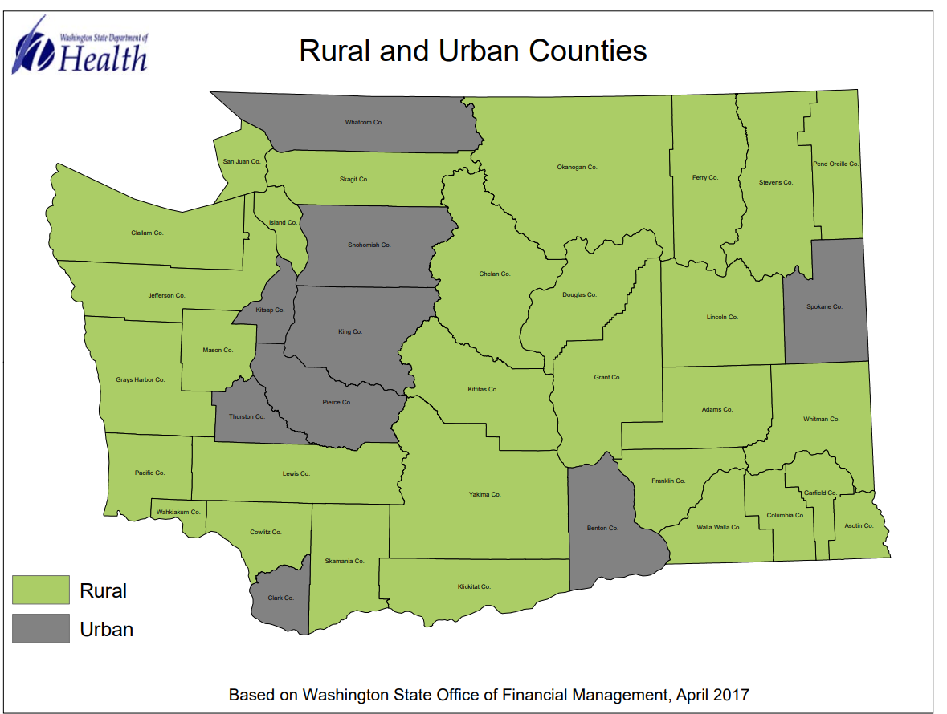
Geographic Breakdown of Rural/Urban Counties
In 1999, RCW 82.14.370 was revised to include a rural county definition based on population density. In this legislation, rural: Counties with a population density less than 100 persons per square mile or counties smaller than 225 square miles
King County is a large population center, composed of both rural and urban areas. Using our application and gathering legislative districts served data, we will ensure we fund both urban and rural areas within King County.
30
9

Slide 6
Rollout Strategy
1. Roll-out:
- Won WA, SBRN, WA small business recovery group, ICAP , WEDA, Washington workforce association, internal agency-wide engagement and outreach teams
2. Scoring and Evaluation criteria:
- Weighted for regional and geographic non profits servicing S/W/BIPOC
3. Are we equitable/ Equity:
- Open application, consultative process, diverse assessors, 2 scheduled webinars during the submittal process
4. Deliverables based contracting method:
- Deliverables Contract: Allows Commerce to pay for work in a non-reimbursable manner, i.e. progress reports, marketing strategies, media, etc.

Slide 7
Reporting/ Deliverables
Reporting Requirements: Quarterly
The report will require the sub recipient to report on the following measurable outcomes quarterly:
Number of Small Businesses Served (RCW 39.26.010 (22))
  Less than 50 employees OR less than $7M in gross revenue annually
Jobs Created
Jobs Retained (Sole proprietorship included)
Women small businesses
Number of BIPOC Businesses served ( Self Select and OMWBE certified)
Location of serviced BIPOC business by county
Served industry sector ( NAICS) code

Slide 8
Application Schedule:
Milestones | Dates
Applications available | August 1st
Q/A Period | August 1st- 10th
Q/A Answers Posted | August 12th
Applications due | September 2nd
Applicants notified of award by | September 20th
Negotiation/contract execution | October 1st
Contract award amounts: Maximum of $5M, minimum of $500,000 awarded to each successful applicant. We will award based on quality of project within the application and ability to execute the timeline of the contract. Minimum of 10 awardees, maximum of 25.
Application Portal
Smartsheet application form.
*Contract performance period: Contract Execution through June 1st 2023.
legislature report September 2023

Slide 9
Contact
Josh Woodson
josh.woodson@commerce.wa.gov
360-522-0429

