Slide 1
Preparing for the Eviction Moratorium Lift T-RAP Grantee – Civil Legal Aid Staff – Dispute Resolution Center Staff – Department of Commerce
June 23, 2021

Slide 3
Agenda
New statewide eviction and homelessness protections
Connecting T-RAP, civil legal aid, and DRC services
Common tenancy challenges
Break out discussions
Partnerships taking place
Discuss other strategies and resources
Notes:
Kathryn

Slide 4
Polls
Who’s here today?
What’s your goal for this meeting?
Notes:
Kathryn

Slide 5
Connecting T-RAP, civil legal aid, and DRC services
T-RAP is a rent assistance program meant to prevent evictions.
Grantees can use T-RAP to pay for Housing Stability Services.
Such services may include housing counseling, fair housing counseling, legal services or attorney’s fees related to eviction proceedings and maintaining housing stability.
T-RAP grantees are required to partner with Dispute Resolution Centers.
T-RAP 2.0 proposes partnering with civil legal aid organizations too.
Dispute Resolution Centers and Civil Legal Aid Organizations will be providing services related to the new eviction prevention/tenancy protections recently passed.
T-RAP grantees will be referring to these services and helping households access them.
Notes:
Kathryn

Slide 6
New statewide eviction and homelessness protections
Reasonable payment schedule for repayment (no more than 1/3 of monthly rent)
Eviction Resolution Pilot Program
Legal services to indigent tenants in eviction proceedings
Restrictions on evictions-limited to 17 “good” reasons
Notes:
Mary

Slide 7
Common Tenancy Challenges
Rent increases during the moratorium.
Landlords changing terms of a lease without notice.
Landlords charging late fees, eviction fees and other fees related to eviction.
Landlords filling out the T-RAP forms with inaccurate information.
Landlords saying that they will move to evict as soon as the moratorium is lifted while they are participating in receiving T-RAP assistance for the arrears.
Landlord
Notes:
Kathryn

Slide 8
Break out discussions
How can we help tenants establish reasonable payment plans
How can we Encouraging tenants to access services
Share out
Notes:
Kathryn

Slide 9
Partnerships taking place
Yakima and Kitsap share outs
Esther Magasis
Director of Human Services
Yakima County
T-RAP Lead Grantee
Kirsten Jewell
Housing and Homelessness Division Manager
Kitsap County
T-RAP Lead Grantee
Notes:
Kathryn

Slide 10
Discuss other strategies and resources
Resources coming from Commerce soon
For T-RAP grantees
List of legal aid contacts
For DRC’s and civil legal aid orgs
T-RAP program overview one pager
List of county specific program variances
List of T-RAP lead grantee contacts
Other
Toll free Eviction Defense Screening line: 855-657-8387, active July 1 and run by Northwest Justice Project
Tenants Union of Washington State hotline: 206-723-0500 or 509-319-0009
www.washingtonlawhelp.org
Notes:
Kathryn

Slide 11
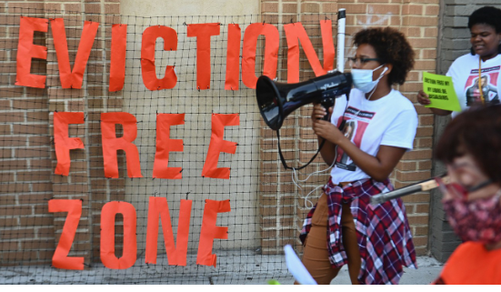
Thank you!
Kathryn Dodge
Mary Baldwin
T-RAP GRANT COORDINATOR, OFFICE OF FAMILY & ADULT HOMELESSNESS
Mary.Baldwin@commerce.wa.gov
Maureen Maples
T-RAP GRANT COORDINATOR, OFFICE OF FAMILY & ADULT HOMELESSNESS
Maureen.maples@commerce.wa.gov
T-RAP program manager, Office of Family & adult homelessness
Kathryn.dodge@commerce.wa.gov

