Slide 1
Landlord Engagement in Rapid Rehousing
Presenter: Katharine Gale Katharine Gale Consulting and Focus Strategies

Slide 2
About This Series
This is one of five video trainings sponsored by the Washington Department of Commerce
Each training will last 30 to 60 minutes
Topics include
Introduction to Housing First
Introduction to Rapid Rehousing
Introduction to Diversion/Problem Solving
Landlord Engagement in Rapid Rehousing
Progressive Engagement for Programs and Systems

Slide 3
Landlord Engagement Session Outline
Refresher: Three Core Components of Rapid Rehousing
A Look at What Landlords Want
How to Engage Landlords
How to Support Continuing Landlord Relationships

Slide 4
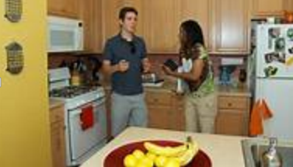
Core Components of Rapid Rehousing
Housing Identification
Financial Assistance
Case Management and Services
FIND
PAY
STAY

Slide 5
What Do Landlords Want?

Slide 6
What Do Landlords Want?
1. Rent Paid
On time
In Full

Slide 7
What Do Landlords Want?
2. Tenants who don’t create problems
With the building
With other tenants
With neighbors
With the law

Slide 8
What Do Landlords Want?
3. Reduced costs/hassles
Low turnover
Easy turnover
Short vacancies
Not spending money on repairs
Not having to formally evict
Notes:
Landlords estimate these total costs to be thousands of dollars per tenant eviction

Slide 9
What Do Landlords Want?
4. Other things (like all of us)
May care about certain issues or people (families, Veterans, etc.)
May not care about things other Landlords do (e.g. criminal background)
May like to be appreciated/acknowledged
Landlords are people

Slide 10
What Do You Have to Offer?

Slide 11
You are in Marketing
Housing Specialists and Case Managers are salespeople for the program participants and for the program
Also sales associates responsible for maintaining the relationships
Think of Landlords as the other client for your program.

Slide 12
What are you bringing?
You have a lot they want
They have a lot to offer you need
Vacant, habitable units
Maybe flexibility on screening criteria
Maybe rent deductions or adjustments
Source of tenants (reduces turnover time and expense)
Guaranteed payments - for a period of time
May be bringing financial incentives
Case management – other tenants generally do not have this

Slide 13
What does Case Management give the Landlord?
Support for the tenant’s success
Eyes on the person and the building
Quick response when needed
Ability to help someone move if it doesn’t work out

Slide 14
Where Do You Find Landlords?
Online, of course
Through Property Owner Associations
Through your Housing Authority
Driving around
From your participants
From other landlords
From your staff and Board members

Slide 15
Starting the Relationship
Provide written program information; be clear what you are offering
Explain role of case management as resource
Provide contact information
If possible have a 24/7 line – otherwise, return calls next day without fail!
Be proactive in maintaining contact
Call each month after rent should have been paid
Drop by when you go see the tenant- and make sure you are home-visiting from time to time
Identify resources for housing partners
Weatherization opportunities, minor repairs

Slide 16
Incentives
Increased Deposits
Lease up Bonuses
Risk Mitigation/Loss Guarantee program
Be careful about funding sources you use for these

Slide 17
WA’s Landlord Mitigation Program
Provides incentive and added security to work with tenants receiving rental assistance
Offers up to $1,000 in reimbursement for some potentially required move-in upgrades
Offers up to fourteen days’ rent loss and up to $5,000 in qualifying damages caused by a tenant during tenancy

Slide 18
WA’s Landlord Mitigation Program
Who can submit a claim?
Any landlord that has screened, approved and offered rental housing to any applicant that will be using any form of housing subsidy program is eligible, except properties operated by housing authorities.
https://www.commerce.wa.gov/serving-communities/homelessness/landlord-fund-programs/landlord-mitigation-program/

Slide 19
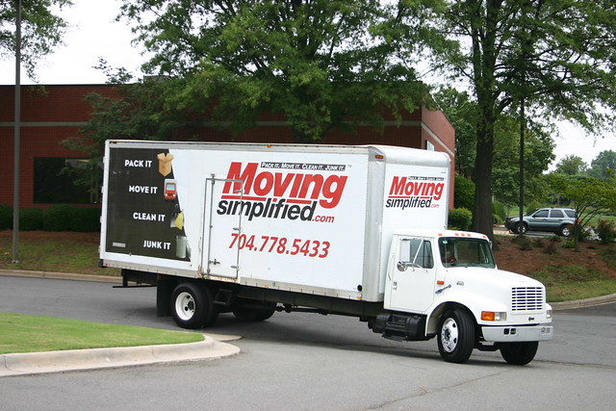
When things aren’t working...
When it’s not working, be proactive – tenancy issues should not be a surprise
Work with tenant to address the concerns – have you explained the lease? Are they getting the support they need?
If have to, move the tenant if they are willing
Even if it doesn’t work out, leave things as best you can; the most important thing you have is your reputation

Slide 20
Recognize your Landlords as Partners
Bring them something at each visit if you can (coffee, donut)
Hold special thank you events
Send formal acknowledgements (certificates,
letters from elected officials)
Send informal acknowledgements (notes, a picture)

Slide 21
Landlord Engagement – It’s not Rapid Rehousing Without It!

Slide 22
For More Information
US Interagency Council on Homelessness
https://www.usich.gov/solutions/housing/landlord-engagement/
National Alliance to End Homelessness
https://endhomelessness.org/resource/rapid-re-housing-landlord-benefits-checklist-2/
Abode Services – Working with Landlords
https://www.abodeservices.org/what_we_do/working_with_landlords

Slide 23
About This Series
Other modules in this series include
Introduction to Housing First Introduction to Rapid Rehousing
Introduction to Diversion/Problem Solving
Progressive Engagement for Programs and Systems

